Slide 1
Exceptions

Slide 2
public void Deposit(double amount)
{
if (amount < 0) // Error detected
{
// now what…?
}
…
}

Slide 3




Error Detection
Error Signaling
Error Capturing
Error Handling

Slide 4
public void Deposit(double amount)
{
if (amount < 0)
{
// now what…?
}
…
}

Slide 5

public void Deposit(double amount)
{
if (amount < 0)
{
Console.WriteLine(…);
}
…
}

Slide 6
public void Deposit(double amount)
{
if (amount < 0)
{
Exception e = new Exception(…);
throw e;
}
…
}

Slide 7

Bank
GUI
Bank
Model
Bank
Account
Collection
Bank
Account
Exception

Slide 8
Windows
Visual
Studio
Bank
GUI
Bank
Model
Bank
Account
Collection
Bank
Account
Exception

Slide 9
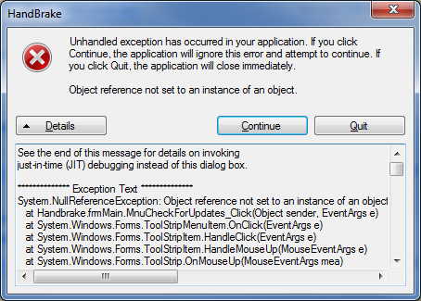

Slide 10

Bank
GUI
Bank
Model
Bank
Account
Collection
Bank
Account
Exception

Slide 11
public void DepositHandler(int accountNo)
{
double amount = GetDepositAmount(…);
try
{
bankModel.Deposit(accountNo, amount);
}
catch (Exception e)
{
// now what…?
}
…
}

Slide 12
public void DepositHandler(int accountNo)
{
double amount = GetDepositAmount(…);
try
{
bankModel.Deposit(accountNo, amount);
}
catch (Exception e)
{
errorHandler.Handle(Action.Deposit, e);
}
…
}

Slide 13
public class IllegalAmountException : Exception
{
public IllegalAmountException()
{
}
public IllegalAmountException(string message)
: base(message)
{
}
}

Slide 14
public void Deposit(double amount)
{
if (amount < 0)
{
IllegalAmountException e =
new IllegalAmountException(…);
throw e;
}
…
}

Slide 15
public void DepositHandler()
{
double amount = GetDepositAmount(…);
try
{
bankModel.Deposit(accountNo, amount);
}
catch (IllegalAmountException e)
{
…
}
…
}

Slide 16
public void DepositHandler()
{
double amount = GetDepositAmount(…);
try
{
bankModel.Deposit(accountNo, amount);
}
catch (IllegalAmountException iae)
{
// Do something…
}
catch (Exception e)
{
// Do something else…
}
…
}

Slide 17
Bank
GUI
catch (Exception e)
{
…
}
Bank
Model
catch (IllegalAmountException e)
{
…
}

Slide 18
Bank
GUI
catch (Exception e)
{
…
}
Bank
Model
catch (IllegalAmountException e)
{
…
}
IllegalAmount
Exception

Slide 19
Bank
GUI
catch (Exception e)
{
…
}
Bank
Model
catch (IllegalAmountException e)
{
…
}

Slide 20
Bank
GUI
catch (Exception e)
{
…
}
Bank
Model
catch (IllegalAmountException e)
{
…
}
Exception

Slide 21
Bank
GUI
catch (Exception e)
{
…
}
Bank
Model
catch (IllegalAmountException e)
{
…
}
Exception

Slide 22
Bank
GUI
catch (Exception e)
{
…
}
Bank
Model
catch (IllegalAmountException e)
{
…
}

Slide 23
Bank
GUI
Bank
Model
Bank
Account
Collection
Bank
Account
Exception

Slide 24
Bank
GUI
Bank
Model
Bank
Account
Collection
Bank
Account
Exception

Slide 25
Bank
GUI
Bank
Model
Bank
Account
Collection
Bank
Account
Exception

Slide 26
Bank
GUI
Bank
Model
Bank
Account
Collection
Bank
Account
Exception

Slide 27
Bank
GUI
Bank
Model
Bank
Account
Collection
Bank
Account

Slide 28
public void DepositHandler(int accountNo)
{
double amount = GetDepositAmount(…);
try
{
bankModel.Deposit(accountNo, amount);
}
catch (Exception e)
{
errorHandler.Handle(Action.Deposit, e);
throw;
}
…
}

Slide 29
Exceptions recommendations
Use typed exception classes
Throw early
Catch late
Consider rethrowing

